Slide 1
MILESTONE 4
Visualization & Admin Controls

Slide 2
📅 Day 1 – Milestone 4 Overview & Visualization Basics
Theory
What is Milestone 4 and why it matters
Role of visualizations in career guidance systems
Types of insights:
Degree → Job role mapping
Domain-wise trends
Overview of Admin Dashboard responsibilities
Hands-on
Review stored prediction data
Decide KPIs for visualization
Task
✅ Identify 3–4 visualizations to be built ✅ Prepare sample dataset for charts

Slide 3
🎯 Objective of Day 1
By the end of Day 1, students will:
Understand the scope and goals of Milestone 4
Learn why visualization and insights are important in ML projects
Identify key education-to-job trends
Plan visualizations to be implemented
Get an overview of the Admin Dashboard

Slide 4
1️⃣ What is Milestone 4?
Milestone 4 focuses on making predictions meaningful and actionable by:
Visualizing education-to-job mappings
Showing career trends and insights
Providing admin control over data, models, and users
Collecting feedback to improve predictions
This milestone converts a working ML model into a decision-support system.

Slide 5
2️⃣ Why Do We Need Visualizations?
Predictions alone are not enough.
Visualizations help users:
Understand why a job role is suggested
See common career paths
Compare their profile with others
Make informed career decisions
Examples:
Degree → Job Role mapping
Job domain distribution
Popular roles for a specialization

Slide 6
3️⃣ Types of Visualizations in This Project
Students will work with:
Bar Charts: Degree vs Job Roles
Pie Charts: Job domain distribution
Trend Charts: Career transitions over time
Comparison Views: User vs similar profiles

Slide 7
4️⃣ Introduction to Admin Dashboard
Admin responsibilities include:
Uploading and managing datasets
Triggering model retraining
Viewing user prediction logs
Reviewing incorrect predictions
Monitoring feedback
Admin panel ensures the system remains accurate, scalable, and reliable.

Slide 8
🛠️ Hands-on Session
Review existing prediction data
Identify fields useful for visualization
Design rough UI layout for:
Visualization dashboard
Admin panel
Decide KPIs and metrics
📝 Task for Students
✅ List 3–4 visualizations to be implemented ✅ Identify required backend data for each chart ✅ Prepare sample dataset (dummy or real) ✅ Push planning notes or UI sketch to GitHub

Slide 9
🎯 Outcome of Day 1
Clear understanding of Milestone 4
Visualization plan finalized
Admin panel scope defined
Ready to implement charts on Day 2

Slide 10
📅 Day 2 – Education-to-Job Trend Visualizations
Theory
Bar charts, pie charts, line charts (use cases)
Mapping education fields to job domains
Understanding trend analysis
Hands-on
Create:
Degree vs Job Role bar chart
Job domain distribution pie chart
Fetch data from backend API
Task
✅ Implement at least 2 charts ✅ Display charts in dashboard UI

Slide 11
🎯 Objective of Day 2
By the end of Day 2, students will:
Understand how to convert data into meaningful charts
Implement education-to-job mapping visualizations
Fetch data from backend APIs for charts
Display charts on the user dashboard
Interpret trends from visual outputs

Slide 12
1️⃣ Understanding Education-to-Job Mapping
Education-to-job mapping shows:
Which degrees lead to which job roles
Most common roles per specialization
Popular job domains for different education fields
This helps users trust and understand ML predictions.

Slide 13
2️⃣ Choosing the Right Chart Type
Bar Chart: Degree vs Job Role frequency
Pie Chart: Job domain distribution
Line Chart: Trend over time (optional)
Explain why each chart is used and what insight it gives.

Slide 14
3️⃣ Data Flow for Visualizations
Database → Backend API → Frontend Chart Component → User Dashboard
Important points:
Aggregated data (counts, percentages)
Clean and formatted API responses

Slide 15
4️⃣ Best Practices for Visualizations
Keep charts simple and readable
Use meaningful labels and legends
Avoid overcrowding data
Show insights, not raw numbers

Slide 16
🛠️ Hands-on Session
Create backend APIs to fetch aggregated data:
Degree vs Job Role count
Job domain distribution
Implement charts on frontend
Integrate APIs with chart components
Test with sample data
📝 Task for Students
✅ Create at least 2 visualization APIs ✅ Implement bar chart for Degree vs Job Role ✅ Implement pie chart for Job Domain distribution ✅ Display charts on dashboard ✅ Push code to GitHub

Slide 17
📅 Day 3 – Career Insights & User Comparison
Theory
What are career insights?
Comparing user profile with similar profiles
Showing alternative career paths
Hands-on
Implement logic to:
Compare user data with dataset
Show common transitions (e.g., Testing → Data Analyst)
Display insights textually + visually
Task
✅ Show 1 comparison-based insight ✅ Save insight logic in backend

Slide 18
🎯 Objective of Day 3
By the end of Day 3, students will:
Understand what career insights mean beyond predictions
Compare a user’s profile with similar profiles
Show alternative career paths
Generate explainable insights from data
Display insights in a user-friendly manner

Slide 19
1️⃣ What Are Career Insights?
Career insights explain:
Why a job role is suggested
How similar profiles progressed
What alternative roles are possible
Insights build user trust in ML systems.

Slide 20
2️⃣ User Comparison Logic
Compare user with others based on:
Degree
Specialization
CGPA range
Certifications
Example Insight:
“70% of students with B.Tech CSE and CGPA > 7.5 became Data Analysts or Software Engineers.”

Slide 21
3️⃣ Alternative Career Pathways
If primary role is not selected:
Suggest adjacent roles
Explain overlap in skills
Highlight required upskilling
Example: Testing Engineer → Data Analyst → Data Scientist

Slide 22
4️⃣ Explainability in ML Systems
Explainability answers:
Why this role?
What skills match?
What skills are missing?
This improves career decision-making.

Slide 23
🛠️ Hands-on Session
Create backend logic to:
Find similar profiles
Calculate common roles
Generate insight text dynamically
Display insights on UI
Show comparison charts or summary cards
📝 Task for Students
✅ Implement similar-profile comparison logic ✅ Show at least 2 career insights ✅ Display alternative role suggestions ✅ Save insights to user history ✅ Push code to GitHub

Slide 24
🎯 Outcome of Day 3
Career insights displayed clearly
User comparison working
Alternative pathways visible
Ready for Admin Controls (Day 4)

Slide 25
📅 Day 4 – Admin Panel: Dataset & Model Management
Theory
Why admin control is needed in ML systems
Dataset versioning
Model retraining lifecycle
Hands-on
Admin features:
Upload new dataset
Trigger model retraining
View training status
Secure admin routes using JWT + role check
Task
✅ Dataset upload working ✅ Retrain trigger API implemented

Slide 26
🎯 Objective of Day 4
By the end of Day 4, students will:
Understand the role of Admin controls in ML systems
Implement dataset upload & management
Trigger model retraining from the admin panel
Secure admin features using JWT & role-based access
Monitor model and data updates

Slide 27
1️⃣ Why Admin Dashboard is Critical
In real-world ML applications:
Data changes over time
Models need retraining
Predictions must be monitored
Admin dashboard allows:
Controlled updates without code changes
Better model accuracy
System reliability

Slide 28
2️⃣ Dataset Management
Admin can:
Upload new datasets (CSV)
Validate dataset structure
Replace or append existing data
Track dataset versions
Explain data versioning and why it matters.

Slide 29
3️⃣ Model Retraining Workflow
Admin uploads dataset
→ Backend validates data
→ Model retraining triggered
→ Model saved
→ Predictions updated
Key concepts:
Training vs inference
Avoid blocking user requests
Maintain previous model backup

Slide 30
4️⃣ Securing Admin Features
Admin-only routes
JWT authentication
Role-based access control
Prevents unauthorized data or model changes.

Slide 31
🛠️ Hands-on Session
Create Admin dashboard UI
Implement dataset upload API
Store dataset metadata
Add retrain model endpoint
Restrict routes to Admin role
📝 Task for Students
✅ Dataset upload working (CSV) ✅ Dataset validation implemented ✅ Model retraining trigger API ✅ Admin-only access enforced ✅ Push code to GitHub

Slide 32
🎯 Outcome of Day 4
Functional Admin dashboard
Dataset management working
Model retraining enabled
Ready for Logs, Feedback & Review (Day 5)

Slide 33
📅 Day 5 – Admin Logs, Feedback & Prediction Review
Theory
Importance of logs and feedback
Handling incorrect predictions
Improving model quality using feedback
Hands-on
View:
User prediction history
Feedback ratings
Admin can flag predictions for review
Task
✅ Feedback stored in DB ✅ Admin review panel functional

Slide 34
🎯 Objective of Day 5
By the end of Day 5, students will:
Understand the importance of logs and feedback in ML systems
Track user prediction history
Implement a feedback mechanism
Allow admins to review and flag predictions
Use feedback to improve system quality

Slide 35
1️⃣ Why Logs Are Important
Logs help admins:
Monitor system usage
Track prediction requests
Debug errors
Audit admin and user actions
Examples of logs:
User login/logout
Prediction requests
Dataset uploads
Model retraining events

Slide 36
2️⃣ User Feedback System
Feedback allows users to:
Rate prediction relevance
Mark suggestions as helpful or not
Why feedback matters:
Identify incorrect predictions
Improve future model performance
Increase user trust

Slide 37
3️⃣ Prediction Review by Admin
Admin can:
View user prediction history
See feedback ratings
Flag incorrect predictions
Mark predictions for review or retraining
This ensures continuous improvement.

Slide 38
4️⃣ Using Feedback for Improvement
Explain conceptually:
Feedback → Analysis → Dataset improvement → Retraining
Feedback does not immediately change predictions
Used during model update cycles

Slide 39
🛠️ Hands-on Session
Implement prediction logs storage
Create feedback form (rating / comments)
Save feedback in database
Admin UI to view and flag predictions
Display feedback summary
📝 Task for Students
✅ Store prediction logs ✅ Implement feedback submission ✅ Display feedback in admin panel ✅ Flag incorrect predictions ✅ Push code to GitHub

Slide 40
🎯 Outcome of Day 5
Logs and feedback system working
Admin can review predictions
System ready for improvement cycle
Ready for Final Testing & Evaluation (Day 6)

Slide 41
📅 Day 6 – Testing, Debugging & Evaluation Prep
Theory
Milestone 4 evaluation checklist
Common issues in admin & visualization modules
Hands-on
End-to-end testing:
Login → Input Education → Prediction
→ Visualization → Admin Review → Feedback
Fix bugs and UI issues
Prepare demo flow
Outcome
🎯 Milestone 4 completed 🎯 Ready for final evaluation

Slide 42
🎯 Objective of Day 6
By the end of Day 6, students will:
Perform end-to-end testing of Milestone 4
Fix common bugs in visualization and admin modules
Validate security and role-based access
Prepare a clean demo flow for evaluation
Finalize all deliverables

Slide 43
1️⃣ Why Testing Is Crucial
Even if features work individually, they must work together.
Testing ensures:
Correct predictions displayed
Visualizations show accurate data
Admin actions reflect immediately
No security loopholes

Slide 44
2️⃣ End-to-End Flow Validation
Students must test the full flow:
User Login
→ Education Input
→ Job Prediction
→ Visualizations
→ Career Insights
→ Feedback Submission
→ Admin Review
→ Logs & Dataset Controls

Slide 45
3️⃣ Common Issues in Milestone 4
Charts not loading due to API errors
Incorrect aggregation logic
Feedback not saving
Admin routes accessible to users
Dataset upload format errors
Discuss how to identify and fix these issues.

Slide 46
4️⃣ Evaluation Checklist
Students must ensure:
All Milestone 4 features implemented
Visualizations clear and meaningful
Admin dashboard fully functional
Feedback and logs visible
UI clean and navigable

Slide 47
🛠️ Hands-on Session
Test all APIs using Postman
Test UI for User and Admin roles
Verify dataset upload & retraining flow
Fix bugs and improve UX
Prepare demo script and screenshots
📝 Task for Students
✅ Complete end-to-end testing ✅ Fix all identified issues ✅ Prepare demo flow ✅ Final code push to GitHub ✅ Keep screenshots & notes ready

Slide 48
Module 4: Visualization and Admin Controls
• Data visualizations of common education-to-job mappings.
• Insights on career transitions and trends based on dataset.
• Admin panel: upload dataset, trigger retraining, manage users and predictions.
• Feedback system for users to rate suggestion relevance.

Slide 49
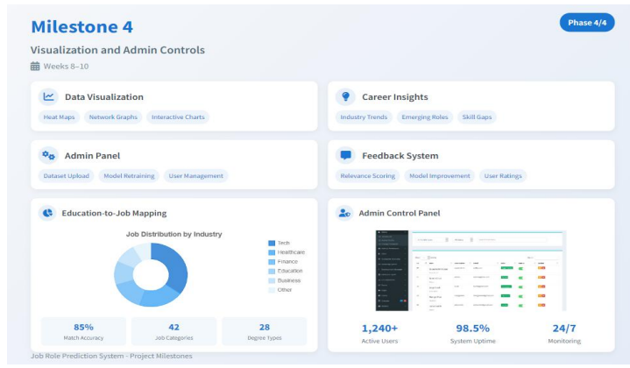

Slide 50
Milestone 4 Evaluation (Week 10):
• Data visualizations and trends are accurately displayed.
• Admin can manage models, data, and user activity.
• Feedback and improvements based on user interactions are possible.

Slide 51
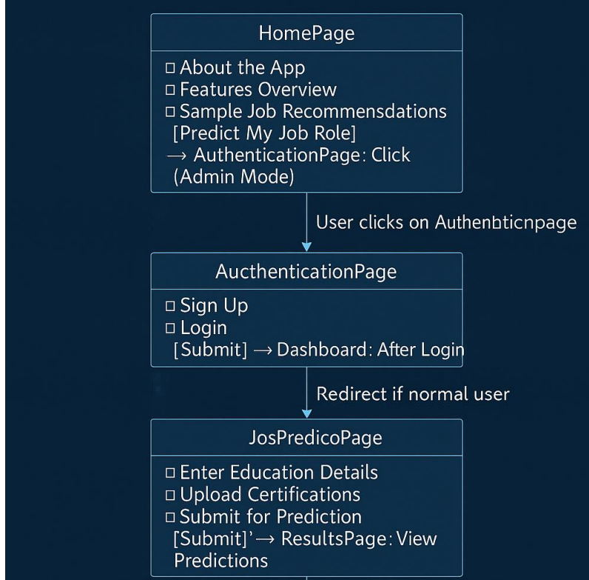

Slide 52
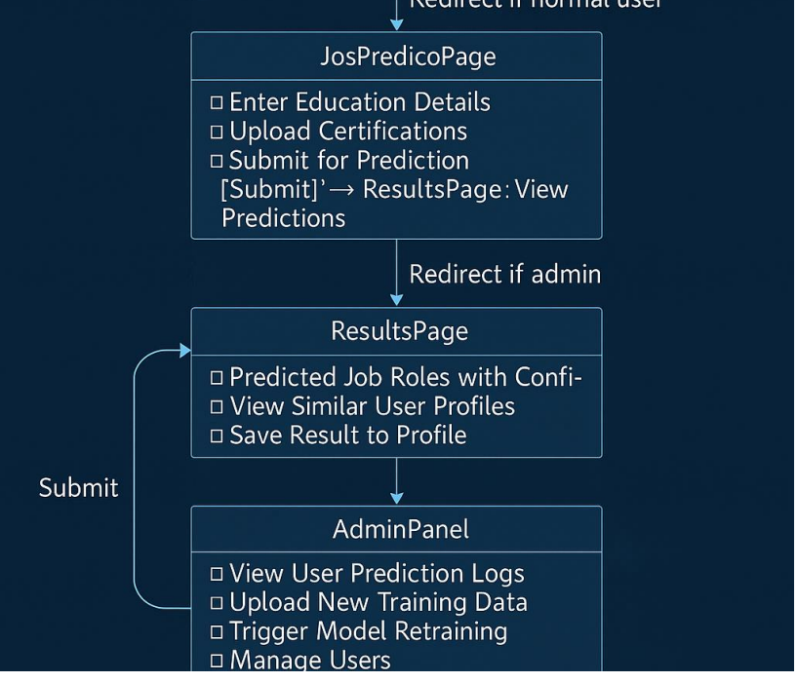

Slide 53
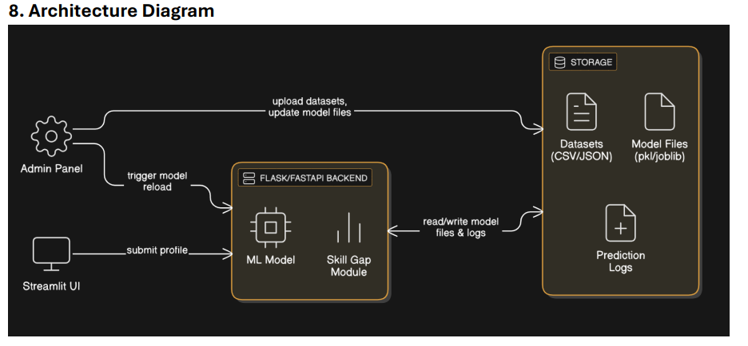

Slide 54
